Slide 1
VCE Matters
Ms. Stammers
February 2022

Slide 2
VCE Matters
GAT Wednesday 7 September, 2022.
The GAT is important! – can be used to calculate a DES
The GAT will be split into two sections – Sections A and B – to be conducted in separate sessions on the same day:
Section A will enable students to demonstrate their achievement against new standards of literacy and numeracy and will be administered in the morning session
Section B will assess students’ skills, including English, mathematics, science, technology, the arts and humanities, and will be administered in the afternoon session
VCE or scored VCE VET Unit 3–4 students sit Sections A and B of the GAT.
Senior VCAL students are expected to sit Section A of the GAT.
.

Slide 3
VCE Matters
If in doubt ask the question.
Special Provision
If you have a documented condition that affects your ability to complete an assessment.
VCAA decide if its legitimate and official documentation is required.
The following is direct from the VCAA
Students may be eligible for Special Provision if, at any time, they are adversely affected in a significant way by:
an acute or chronic illness (physical or psychological)
factors relating to personal circumstance
an impairment or disability, including a learning disorder.

Slide 4
VCE Matters
Upcoming Requirements
Personal Details form. Make sure they are all correct. Put in a personal email address instead of a school address.
Read updated VCE handbook.
Familiarise yourself with the VCE Matters page
https://www.stbedes.catholic.edu.au/vce-matters/
*Can be accessed through SIMON or Student Portal on the school website

Slide 6
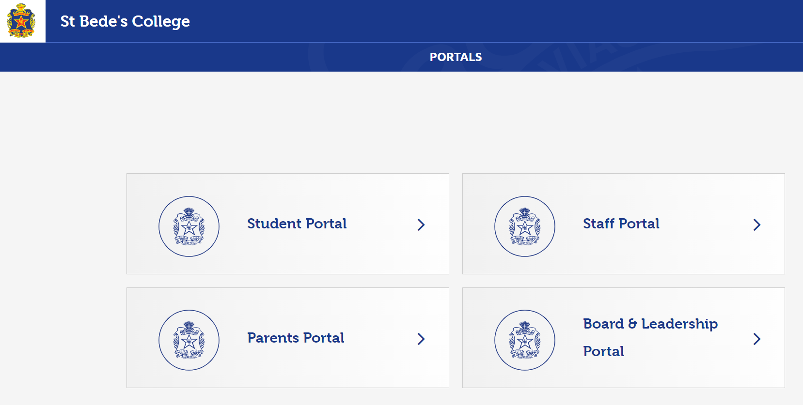

Slide 7
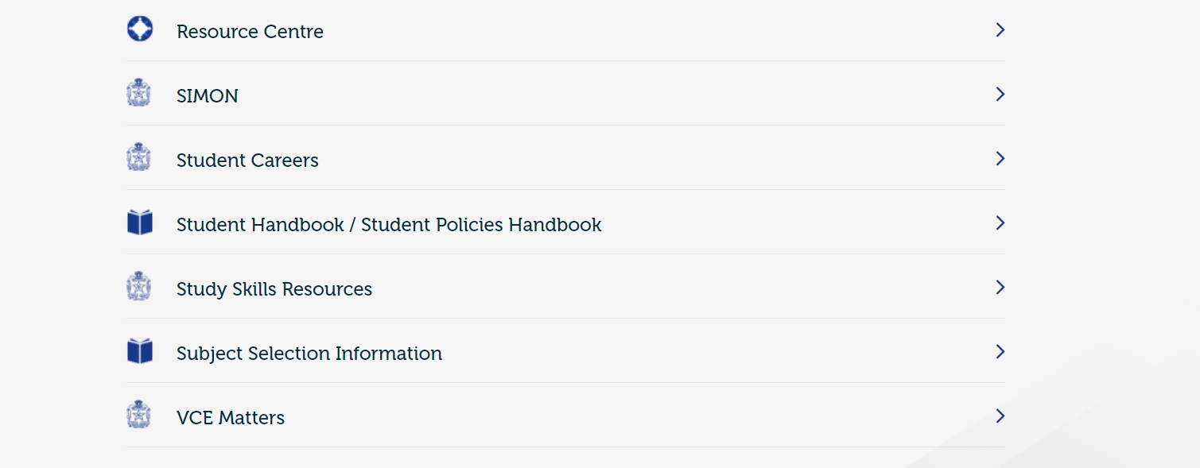

Slide 8
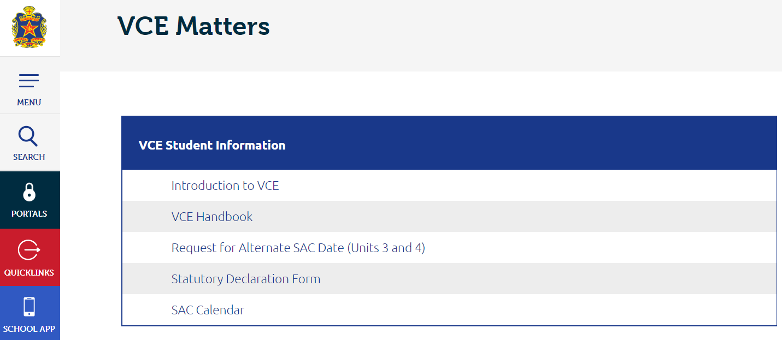

Slide 9
VCE Matters
SACs and SATs
SAC Calendar is ready to be viewed (Unit 3 – Terms 1 & 2)
Study and record when your SACs are scheduled.
There will be some days and weeks when you have multiple SACs. Plan now. This is your workload.
If you are completing folio pieces then it is your responsibility to secure your work. Take photos, have backups, show your teacher regularly – have evidence that you have done it.

Slide 11
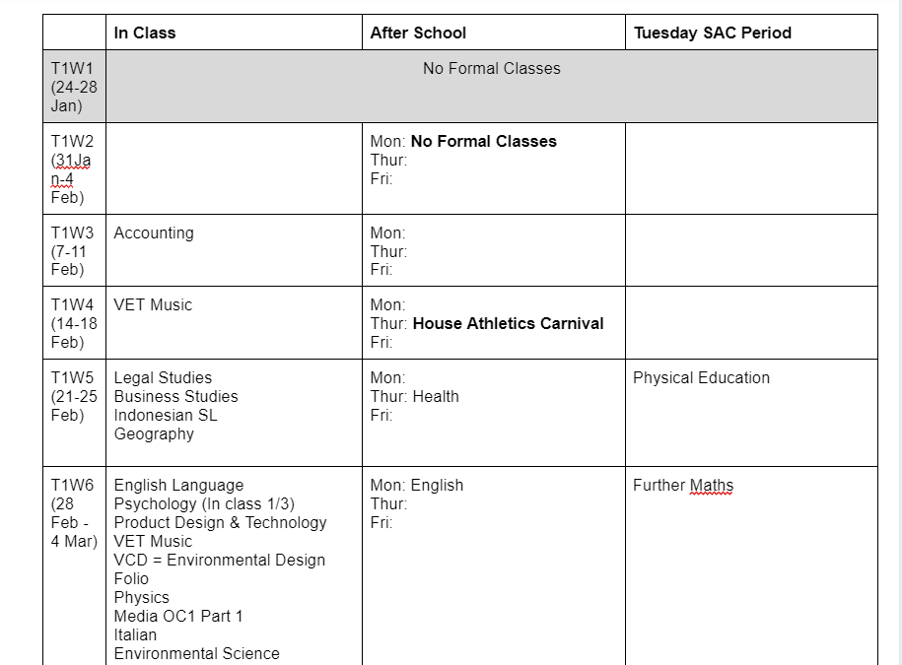

Slide 12
VCE Matters
Missing a SAC
Alternative SAC/SAT Form (VCE Matters Page)
Google Form and documentation is required before or 24 hours after the missed SAC

Slide 14
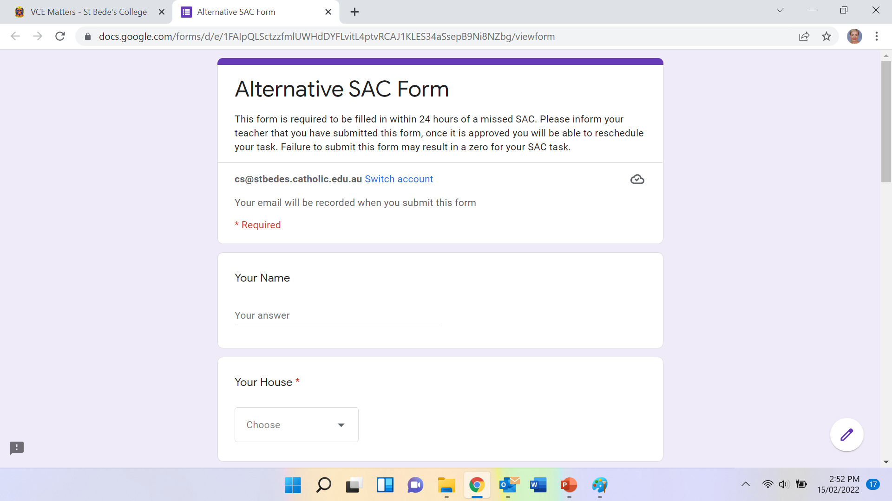

Slide 15
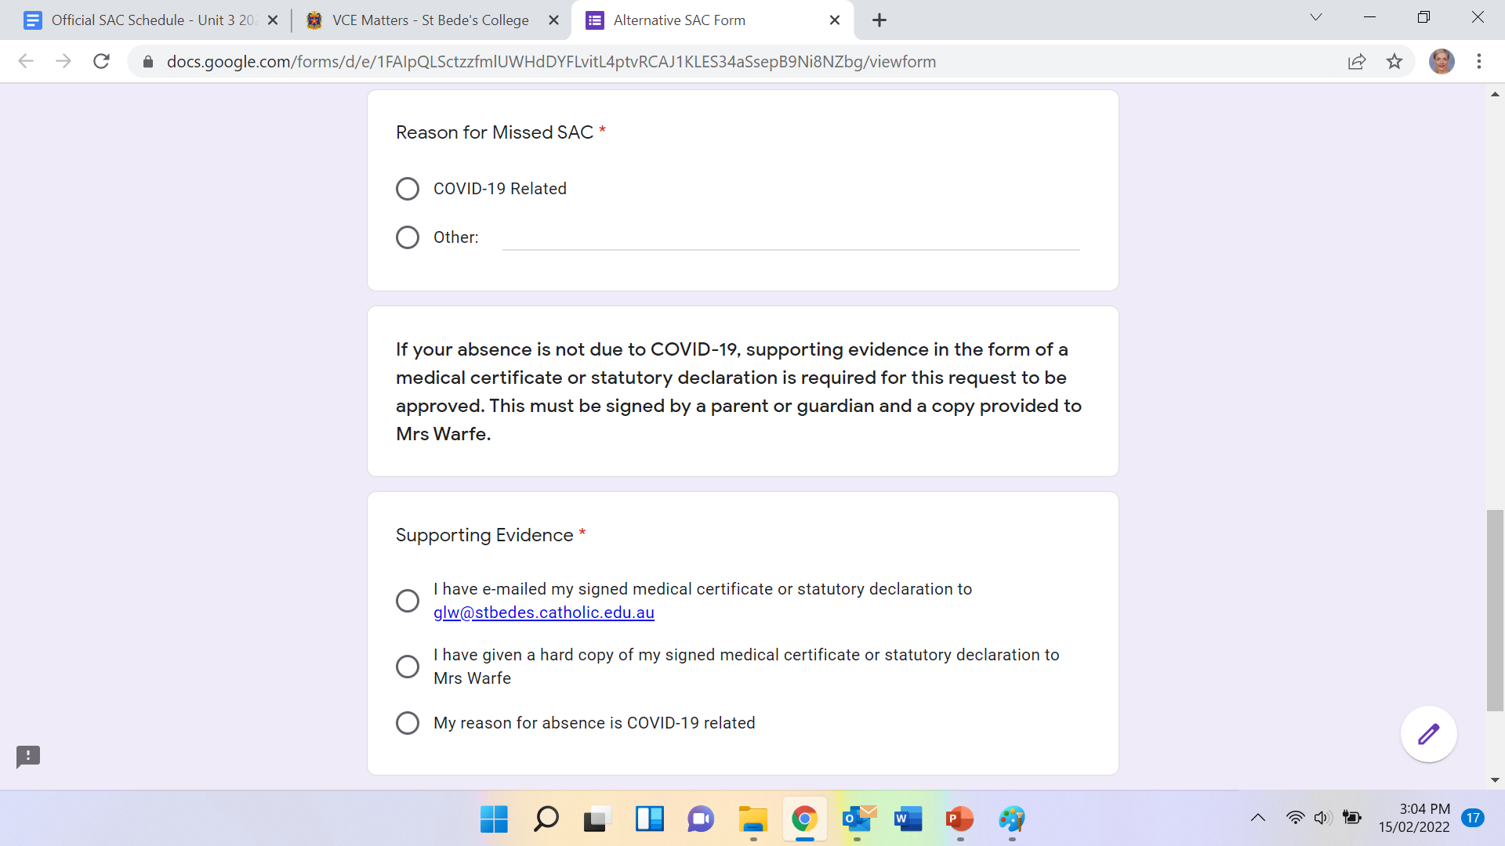

Slide 17
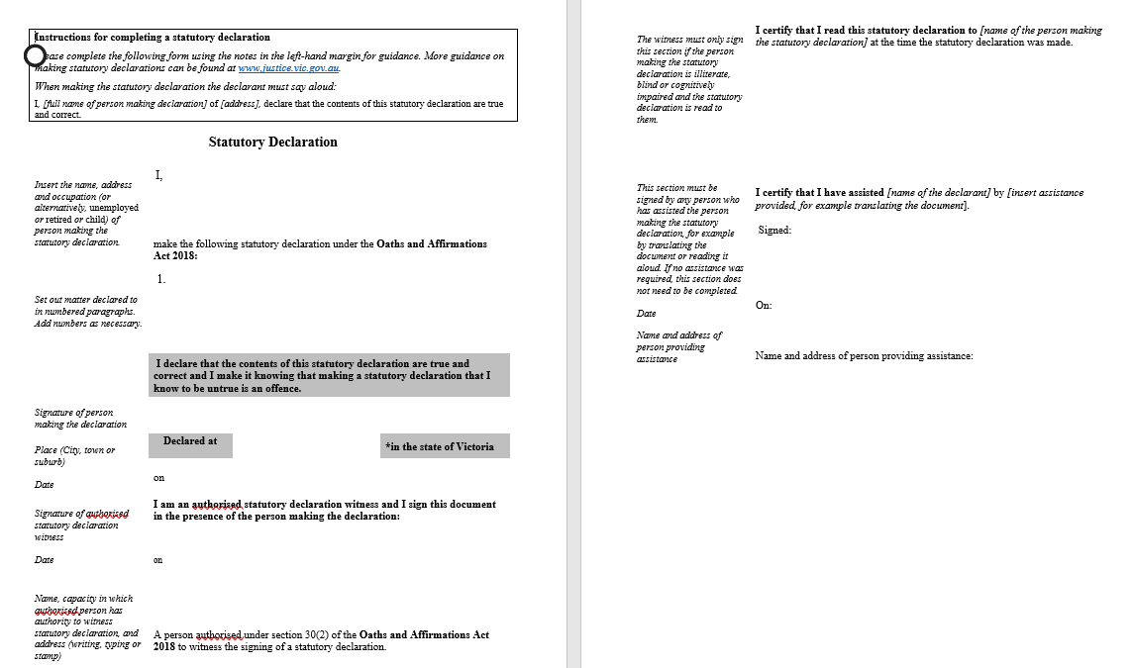

Slide 18
VCE Matters
Things to remember
Family vacations are not a valid excuse to miss a SAC or miss a deadline.

Slide 19
VCE Matters
VCE Panel / Breach of VCE Rules
Mobile phones and smart watches are strictly prohibited. Never take a device into a SAC or an examination.
Only take approved VCAA materials into a SAC (clear water bottles, no whiteout, approved calculators, dictionary with no handwriting in it, etc).
Students with a high number of absences (usually more than 10% of classes missed) throughout the semester will be unable to meet the College’s attendance policy and may, as a result, receive an N (Not Satisfactory) for that Unit of study.
Students who submit work that does not satisfactorily demonstrate knowledge and skills may receive a Provisional N.

Slide 20
VCE Matters
VCE Study Habits –Year 11 Students
We are hear to support and help you
What are YOU going to do to help YOU though this year?
Unit 3 & 4 is hard!
Don’t look back and regret time and opportunities lost

Slide 21
VCE Matters
VCE Study Habits –Year 12 Students
Inappropriate use of electronic devices during these lessons
In lieu of a cancelled Assembly at the beginning of the year, Mr Mair emailed you all regarding Study Hall Expectations
Staff were sent a survey regarding student behaviour in accordance with the Study Hall guidelines.
“no more than a rating above 2”

Slide 22
VCE Matters
VCE Study Habits –Year 12 Students
Only one teacher rated a study hall class higher than a ‘2’.
Individually - What do you need to do?
- What environment can you create that supports your best learning?
Team - VCE is a Team effort –
do not drag your class/peers down
There are more of you than there are staff members
- call this behaviour out

